Slide 1
5-1. Unsupervised learning (clustering)
Youngsoo Kim <pineland@hanmail.net>
Code : https://github.com/pineland/AIDA/
Notes:
* https://ratsgo.github.io/machine%20learning/2017/04/16/clustering/

Slide 2
Contents
Unsupervised learning (clustering) concept
Clustering issues & solutions
Types of clustering
Clustering algorithms
K-means clustering
Hierarchical clustering

Slide 3
Computer learning methods
Unsupervised Learning
Clustering
Semi-Supervised Learning
Supervised Learning
Reinforcement Learning

Slide 4
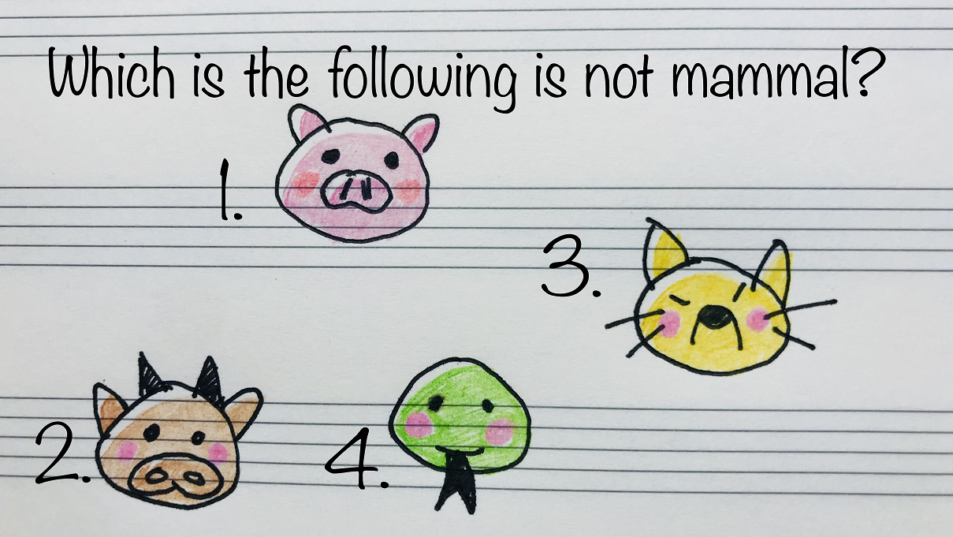

Slide 5
Unsupervised learning
Definition
Finding specific patterns (attributes) for data without result information.
Identifying the structure and characteristics inherent in the data
The purpose of unsupervised learning
Clustering
Density estimation
Dimensionality reduction

Slide 6
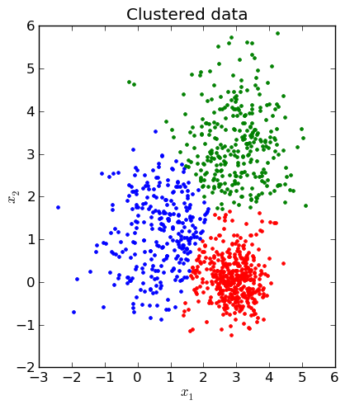
Clustering
Definition
find natural groupings among objects of similar characteristics
a sort of unsupervised learning
Why does clustering to be need?
In reality, there are often occurred in cases that we do not know any information about data (label, category, or etc.)

Slide 7
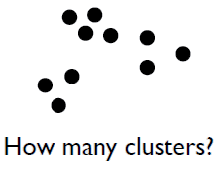
Clustering issues
How to divide the group?
How to measure the similarity?
How to measure the success of clustering?
“The quality of clustering results depends on algorithms, distance measurement methods, etc.”

Slide 8

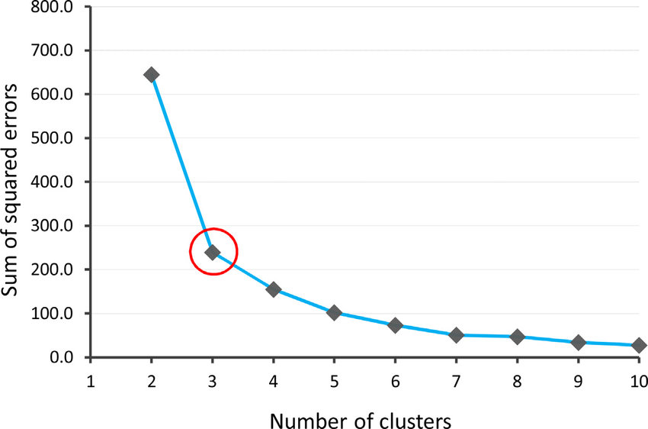
How to divide group? (=how many clusters?)
No answer to select how many clusters
Proposed methods
Rule of thumb
In the simplest way, if the number of data is n, the number of clusters can be calculated as follows:
Elbow Method
While increasing the number
of clusters sequentially, it
monitors the results and
determines the optimal
number of clusters.

Slide 9
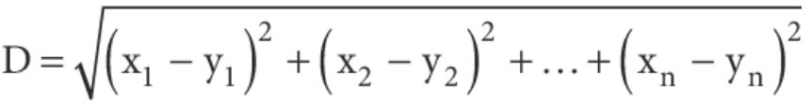

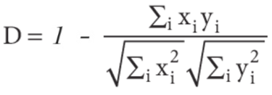
How to measure the similarity? (distance function)
Numerical values
Euclidean distance
Manhattan distance
Cosine distance

Slide 10
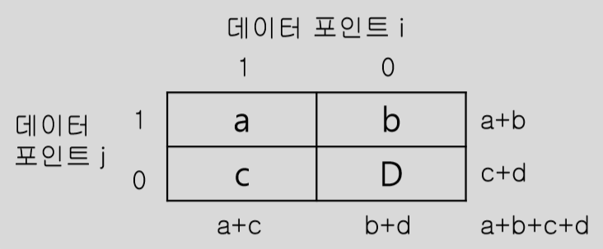
Distance functions
Discrete / categorical values
Use matrix to define a distance function

Slide 11
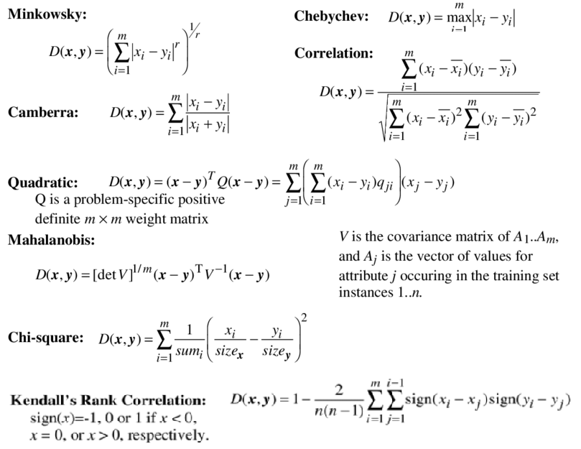
Other distance functions

Slide 12
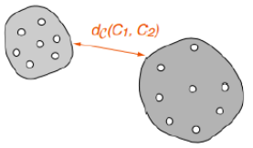
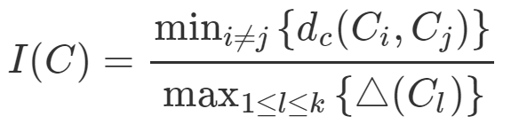
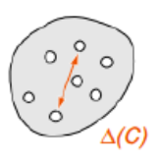
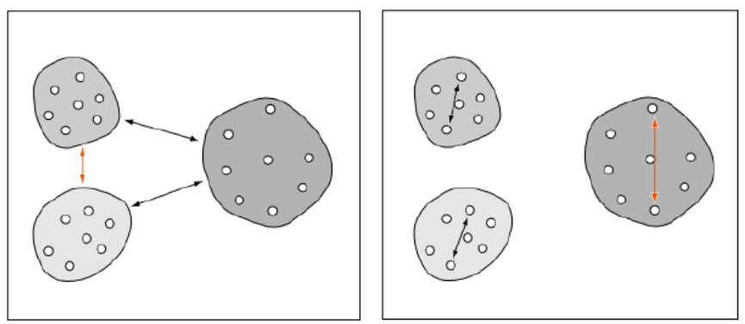
How to measure the success of clustering? (clustering validity index)
Dunn Index
The farther the distance between clusters and the smaller the variance within a cluster, I(C) become bigger.

Slide 13
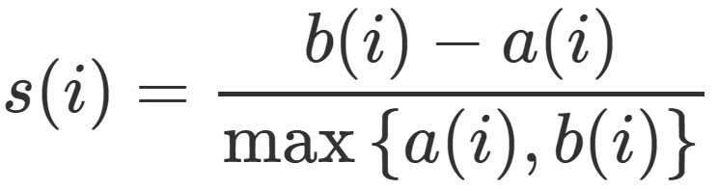
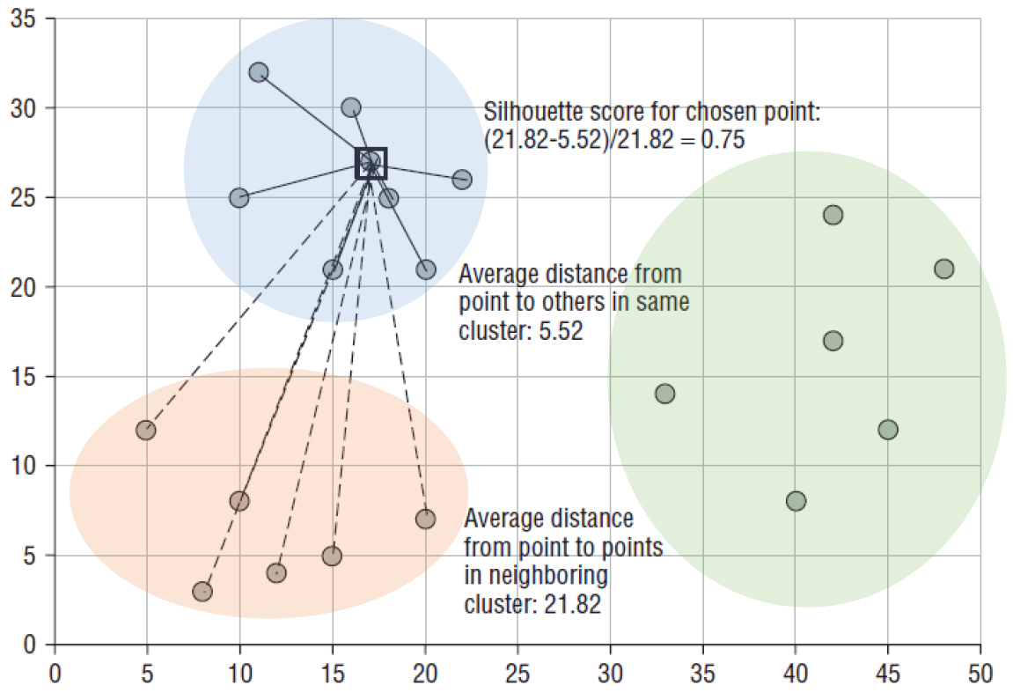
Silhouette (-1 ~ 1)
a(i) : average distance btw i-th object and the other elements in the same cluster
b(i) : average distance btw i-th object and the other elements in the nearest cluster
* s(i) : -1 ~ +1
If s(i)>0.5,
the cluster result is usually considered to be valid.
Notes:
https://ratsgo.github.io/machine%20learning/2017/04/16/clustering/

Slide 14
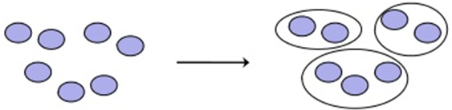
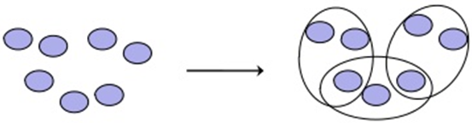
Types of Clustering
Hard clustering
Every object may belong to exactly one cluster.
Soft clustering
Objects may belong to several clusters with a fractional degree of membership in each

Slide 15
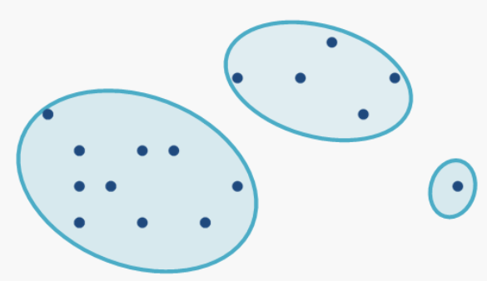
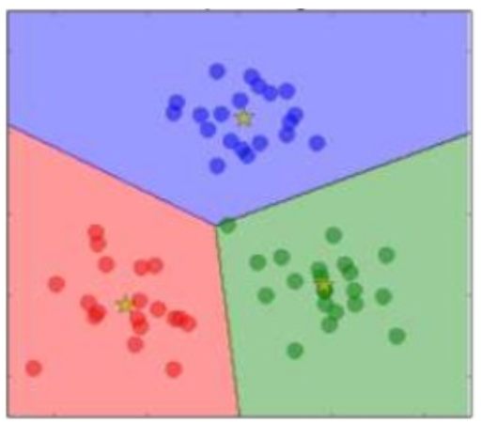
Types of Clustering
Partitional clustering
Partition the data space
Finds all clusters simultaneously
K-means algorithm

Slide 16
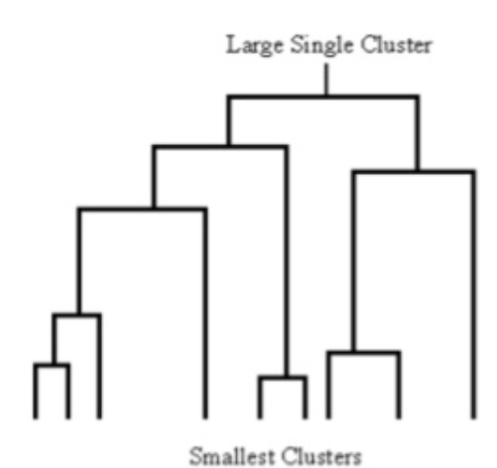
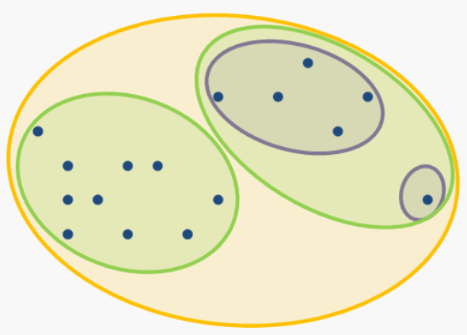
Types of Clustering
Hierarchical clustering
Generate nested cluster hierarchy
Agglomerative (bottom-up)
Divisive (top-down)

Slide 17
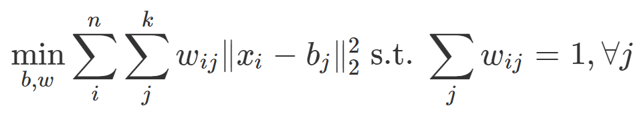
Clustering algorithms
K-means Clustering
The number of clusters, k, is given and each cluster has one 'center‘.
Define how close to the center of each data as “cost”.
K-means clustering is to Find the cluster that reduces cost the most
- b_{j} : the central of the j^{st} cluster
- w_{ij} : if the i-data belongs to the j-cluster, 1 or 0

Slide 18
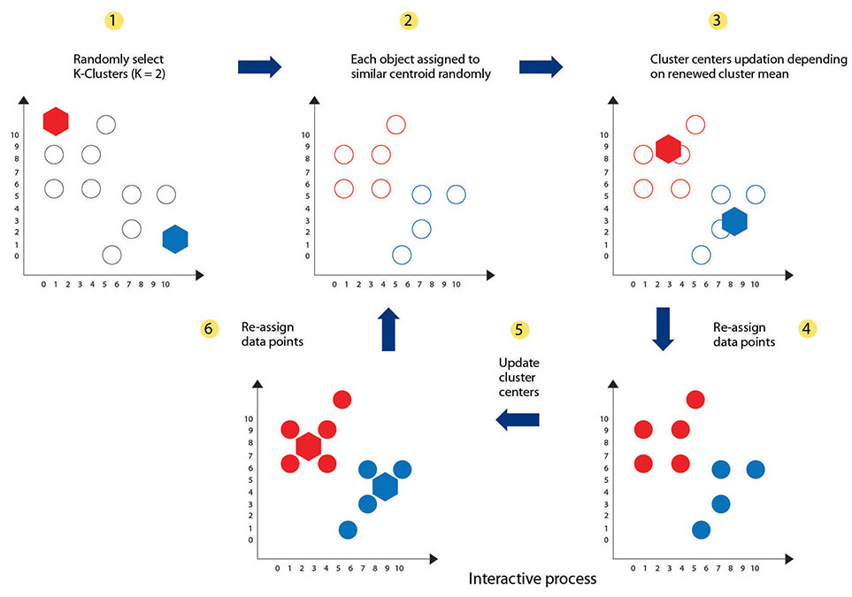
Repeat until centroid (center point) no change; or SSE (Sum of Squared Error) converges within a
certain range.

Slide 19
K-means Clustering
Advantages
Easy to understand and implement
Having an efficient time-complexity : O(tkn)
n : Number of data points
k : Number of clusters
t : Count of cluster reassignments
Since the value of k and t is small, the complexity
can be “linear”.

Slide 20
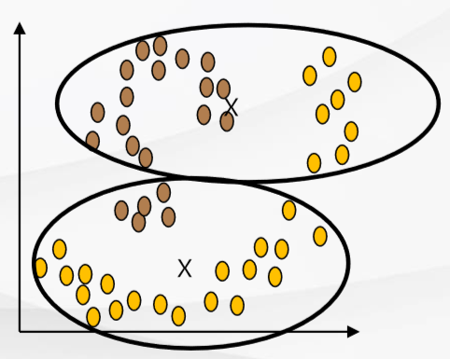
K-means Clustering
Limitations of K-means
Only can be applied for data where the average value of data is able to be defined.
Difficult to find the most optimal value of K.
Very Sensitive to Outliers.
Not suitable for finding clusters that are not elliptical (e.g. rings)

Slide 21
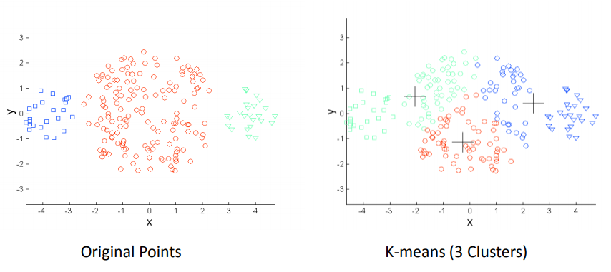
K-means Clustering
Limitations of K-means (cont’)
Differing “Sizes”

Slide 22
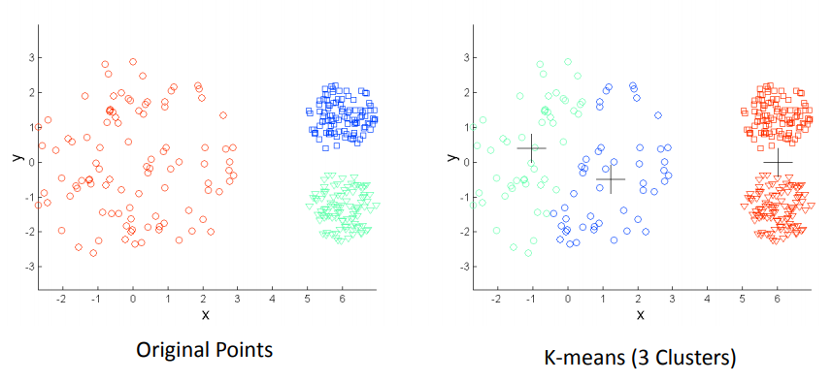
K-means Clustering
Limitations of K-means (cont’)
Differing “Density”

Slide 23
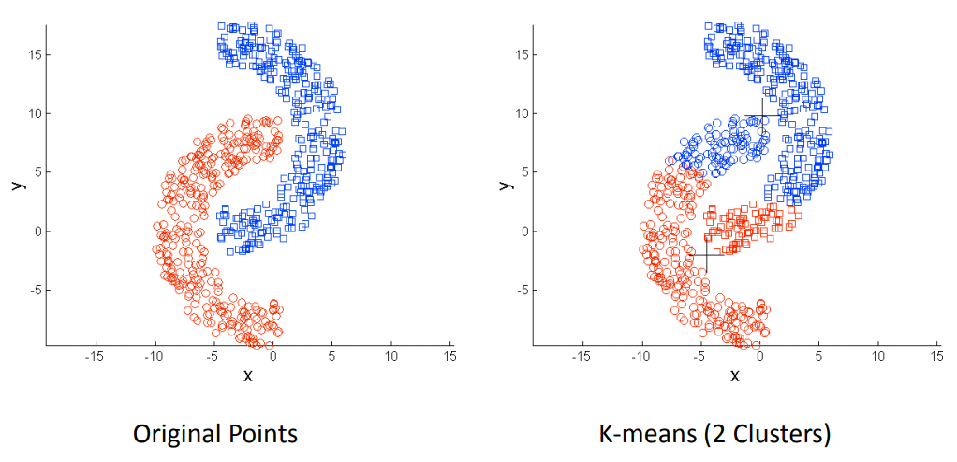
K-means Clustering
Limitations of K-means (cont’)
Non-globular Shapes

Slide 24
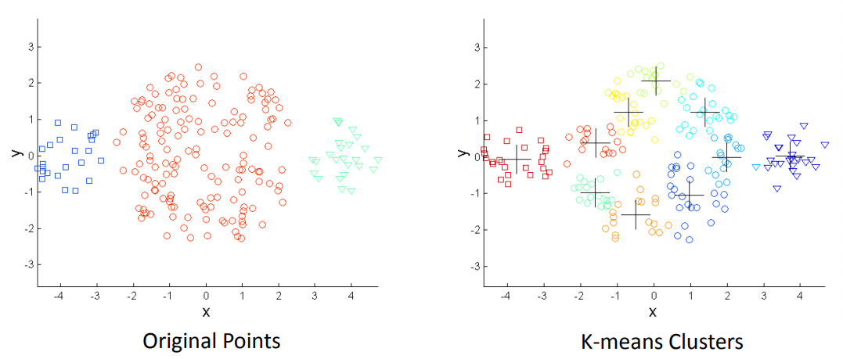
K-means Clustering
Overcoming K-means Limitations
One solution is to use many clusters.
“Find parts of clusters, but need to put together.”

Slide 25
Clustering applications
Image segmentation
Digital images are divided into similar parts.
Vector quantization
Color (vector) quantification reduces the number of colors used in the image to k colors.
Auto-labeling
Automatically process hard-to-label big data in advance for supervised learning.

Slide 26

Q & A

